Slide 1
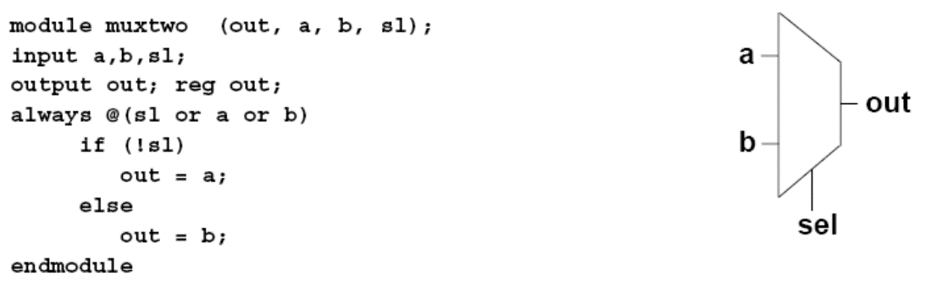
Outline
Part 2 (Behavior Verilog for design)
Behavior level modeling
Tools and hardware specific
Simulator and race conditions
Finite State Machine Design
SystemVerilog for design
Verilog Modeling Style for Synthesis
Gotchas

Slide 2
Behavior level modeling view from Level of abstraction
Notes:
9 pages

Slide 3
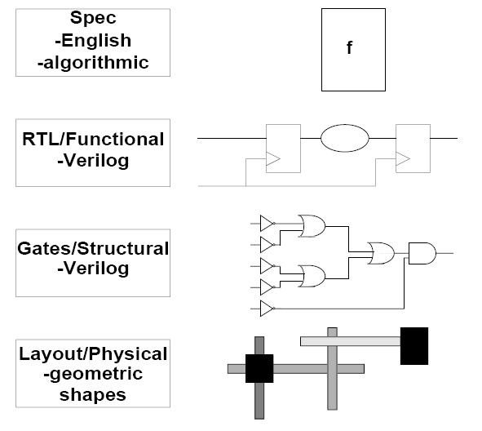
Levels of Abstraction
One design, many coding styles to describe hardware functions
Faster simulation
(Less detailed)
C / matlab / systemC …
Behavior style Verilog: always
Dataflow style Verilog: assign
Structural or gate level Verilog
Slower simulation
(More detailed)

Slide 4
Review: Gate-level Verilog uses structural Verilog to connect primitive gates
module mux4( input a, b, c, d, input [1:0] sel, output out );
wire [1:0] sel_b;
not not0( sel_b[0], sel[0] );
not not1( sel_b[1], sel[1] );
wire n0, n1, n2, n3;
and and0( n0, c, sel[1] );
and and1( n1, a, sel_b[1] );
and and2( n2, d, sel[1] );
and and3( n3, b, sel_b[1] );
wire x0, x1;
nor nor0( x0, n0, n1 );
nor nor1( x1, n2, n3 );
wire y0, y1;
or or0( y0, x0, sel[0] );
or or1( y1, x1, sel_b[0] );
nand nand0( out, y0, y1 );
endmodule
b
d
a
c
sel[1]
sel[0]
out
6.375 Complex Digital Systems

Slide 5
One language, Many Coding Styles
Model combinational logic
Dataflow style
“Behavioral style”
“Structural style”
Continuous assignment
Procedural assignment
wire E;
and g1(E,A,B);
not g2(Y,C);
or g3(X,E,Y);
wire E;
assign E = A & B;
assign Y = ~C;
assign X = E | Y;
reg E, X, Y;
always @ (A or B or C)
begin
E = A & B;
Y = ~C;
X = E | Y;
end
Same as schematic
Similar to logic equations
Use “assign”
Similar to high level language
Use “always”

Slide 6
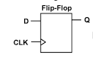
One language, Many Coding Styles
Model seq. logic
Dataflow style
“Behavioral style”
“Structural style”
Continuous assignment
Procedural assignment
wire E;
and g1(E,A,B);
not g2(Y,C);
or g3(X,E,Y);
wire E;
assign E = A & B;
assign Y = ~C;
assign X = E | Y;
reg E, X, Y;
always @ (A or B or C)
begin
E = A & B;
Y = ~C;
X = E | Y;
end
reg q;
always @ (posedge clk)
q <= d;
Same as schematic
Similar to logic equations
Use “assign”
wire q;
dff d1(.d(d),
.clk (clk))
Similar to high level language
Use “always”

Slide 7
One language, Many Coding Styles
Model combinational logic
Structural style
Continuous assignment
Procedural assignment
Model sequential logic
Structural style
Procedural assignment

Slide 8
Continuous vs. Procedural Assignment
Continuous assignment
Like logic equations
Single line Verilog statement
For simple logic
Each assignment statement is executed in parallel
Order does not matter
For combinational logic only
Procedural assignment
a separate activity flow in Verilog
For combinational logic or
Single or multiple blocking Verilog statements (=)
Easy to describe complex logic
Order matters
sequential logic
Nonblocking Verilog statements (<=)
Executed in parallel
Order does not matter
Different procedural executed in parallel
wire E;
assign E = A & B;
assign Y = ~C;
assign X = E | Y;
reg E, X, Y;
always @ (A or B or C)
begin
E = A & B;
Y = ~C;
X = E | Y;
end
always_com
reg q;
always @ (posedge clk) begin
q <= d;
x <= q;
end
wire E;
assign Y = ~C;
assign X = E | Y;
assign E = A & B;

Slide 9
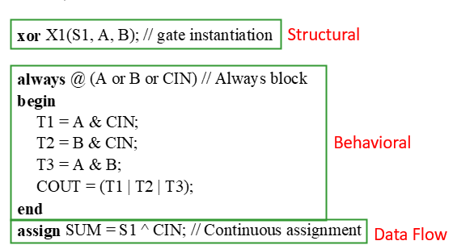
Concurrent blocks (Optional)
Blocks of code with no well-defined order relative to one another
Module instance is the most important concurrent block
Continuous assignments, and procedural blocks are concurrent within a module
Note. Hardware is concurrently executed

Slide 10


Continuous assignment statements assign one net to another or to a literal
Explicit continuous assignment
wire [15:0] netA;
wire [15:0] netB;
assign netA = 16’h3333;
assign netB = netA;
Implicit continuous assignment
wire [15:0] netA = 16’h3333;
wire [15:0] netB = netA;
Implicit net declaration (not recommended)
– If a signal name is used to the left of a continuous assignment, a implicit net declaration will be inferred
6.375 Complex Digital Systems

Slide 11
Using continuous assignments to implement an RTL four input multiplexer
Circuit topology
module mux4( input a, b, c, d
input [1:0] sel,
output out );
wire out, t0, t1;
assign t0 = ~( (sel[1] & c) | (~sel[1] & a) );
assign t1 = ~( (sel[1] & d) | (~sel[1] & b) );
assign out = ~( (t0 | sel[0]) & (t1 | ~sel[0]) );
endmodule
t0
out
t1
先後順序不重要
Same result if you write like this
The order of these continuous assignment statements does not matter.
They essentially happen in parallel!
assign out = ~( (t0 | sel[0]) & (t1 | ~sel[0]) );
assign t1 = ~( (sel[1] & d) | (~sel[1] & b) );
assign t0 = ~( (sel[1] & c) | (~sel[1] & a) );
But better to follow the circuit topological order
6.375 Complex Digital Systems
Notes:
assign 順序不重要，都是平行執行
建議寫法
照電路順序依次寫

Slide 12
Using continuous assignments to implement an RTL four input multiplexer
Circuit topology
module mux4( input a, b, c, d
input [1:0] sel,
output out );
wire out, t0, t1;
assign t0 = ~( (sel[1] & c) | (~sel[1] & a) );
assign t1 = ~( (sel[1] & d) | (~sel[1] & b) );
assign out = ~( (t0 | sel[0]) & (t1 | ~sel[0]) );
endmodule
t0
out
t1
Same result if you write like this
The order of these continuous assignment statements does not matter.
They essentially happen in parallel!
assign out = ~( (t0 | sel[0]) & (t1 | ~sel[0]) );
assign t1 = ~( (sel[1] & d) | (~sel[1] & b) );
assign t0 = ~( (sel[1] & c) | (~sel[1] & a) );
But better to follow the circuit topological order
6.375 Complex Digital Systems
Notes:
assign 順序不重要，都是平行執行
建議寫法
照電路順序依次寫

Slide 13
Procedural blocks
Notes:
9 pages

Slide 14
Procedural blocks
Each procedural block represent a separate activity flow in Verilog
Procedural blocks
always blocks
To model a block of activity that is repeated continuously
initial blocks simulation only
To model a block of activity that is executed at the beginning
Multiple behavioral statements can be grouped using keywords begin and end

Slide 15
Procedural assignments
Procedural assignment changes the state of a reg
Used for both combinational and sequential logic inference
All procedural statements must be within always (or initial) block
reg A;
always @ (B or C)
begin
A = ~(B & C);
end
Feel confusing?
Use logic
logic A;
always @ (B or C)
begin
A = ~(B & C);
end
Sensitivity list
Signal changes triggers actions in the body
Output should use reg declaration for variable

Slide 16
Always blocks have parallel inter-block and sequential intra-block semantics
module mux4( input a, b, c, d
input [1:0] sel,
output out );
reg out, t0, t1;
always @( a or b or c or d or sel )
begin
t0 = ~( (sel[1] & c) | (~sel[1] & a) );
t1 = ~( (sel[1] & d) | (~sel[1] & b) );
out = ~( (t0 | sel[0]) & (t1 | ~sel[0]) );
end
endmodule
ORDER MATTERS in procedural blocks
Executed sequentially from top to bottom
The always block run once whenever a signal in its sensitivity list changes
6.375 Complex Digital Systems

Slide 17
Sensitivity List in always
module mux4( input a, b, c, d
input [1:0] sel,
output out );
reg out, t0, t1;
always @( a or b or c or d or sel )
begin
t0 = ~( (sel[1] & c) | (~sel[1] & a) );
t1 = ~( (sel[1] & d) | (~sel[1] & b) );
out = ~( (t0 | sel[0]) & (t1 | ~sel[0]) );
end
endmodule
What happens if we accidentally forget a signal on the sensitivity list?
Simulation will miss, but synthesis will ignore the sensitivity list
=> Simulation synthesis mismatch
6.375 Complex Digital Systems

Slide 18
Auto sensitivity list in always
module mux4( input a, b, c, d
input [1:0] sel,
output out );
reg out, t0, t1;
always @( * )
begin
t0 = ~( (sel[1] & c) | (~sel[1] & a) );
t1 = ~( (sel[1] & d) | (~sel[1] & b) );
out = ~( (t0 | sel[0]) & (t1 | ~sel[0]) );
end
endmodule
Feel confusing?
Use always_comb
always_comb
begin
t0 = ~( (sel[1] & c) | (~sel[1] & a) );
t1 = ~( (sel[1] & d) | (~sel[1] & b) );
out = ~( (t0 | sel[0]) & (t1 | ~sel[0]) );
end
Verilog-2001 provides special syntax to automatically create a sensitivity list for all signals read in the always block
6.375 Complex Digital Systems

Slide 19
Always block – Event control @
Always blocks model an activity that is repeated continuously
@ can control the execution
posedge or negedge make sensitive to edge
@* / @(*), are sensitive to any signal that may be read in the statement group
Use “,”/or for multiple signals
Logic specific always in SystemVerilog
always_comb
always_ff
always_latch

Slide 20
Always block – Event control @
module M1 (input B, C, clk, rst, output reg X, Y,Z);
// controlled by any value change in B or C
always @ (B or C) X = B & C;
// Controlled by positive edge of clk
always @(posedge clk) Y <= B & C;
// Controlled by negative edge of clk or rst
always @(negedge clk, negedge rst)
if (!rst) Z <= B & C; else Z <= B & C;
endmodule
Blocking assignment
NonBlocking assignment

Slide 21
Procedural blocks (summary)
Blocks of code within a concurrent block which are read (simulated, executed) in order
Procedural blocks may contain:
Blocking assignments
Nonblocking assignments
Procedural control statements (if, for, case)
function, or task calls
Event control (‘@’)
procedural blocks enclosed in begin … end

Slide 22
Blocking vs. nonblocking
Notes:
9 pages

Slide 23
Procedural Assignment
Assign value to registers
Blocking procedural assignment (for combinational logic)
Use “=”
An assignment is completed before the next assignment starts
Use for always@(*) always_comb
Non-blocking procedural assignment (for sequential logic)
Use “<=”
Assignments are executed in parallel
Use for always@(posedge clock)

Slide 24
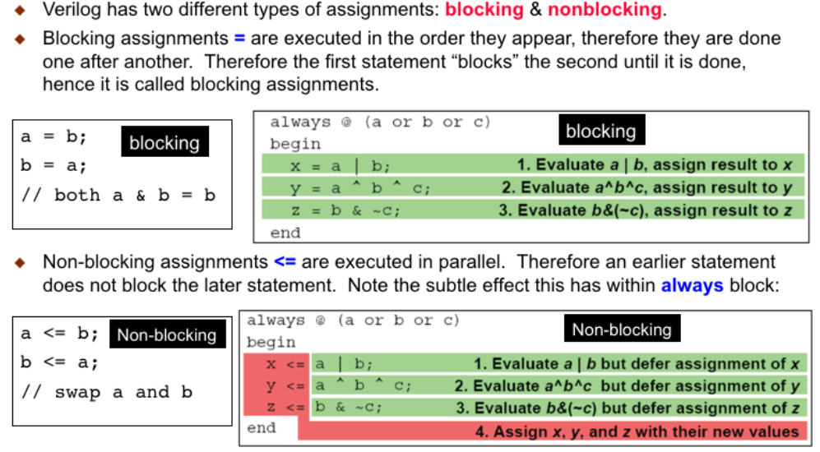
Blocking v.s. NonBlocking
Notes:
immediately at the end of the statement.
RHS算完馬上更新結果(LHS)
RHS算完等最後always 結束再更新 結果(LHS)
In Verilog ‘=‘ is known as blocking assignment. They are executed in the order they appear within the Verilog simulation environment. So the first ‘=‘ assignment blocks the second one. This is very much like what happens in C codes.
In the top left example, both a and b eventually have the value b.
In the top right example, each statement is evaluated in turn and assignment is performed
Non-block assignment is ‘<=‘, and statements with this assignments are executed in parallel (i.e. order do not matter).
In the bottom left example, a and b are swapped over because you can view that the two assignments happen at the same time.
In the bottom right example, three evaluations are made, and the assignment to x, y and z happens at the same time on exiting from the always block.

Slide 25
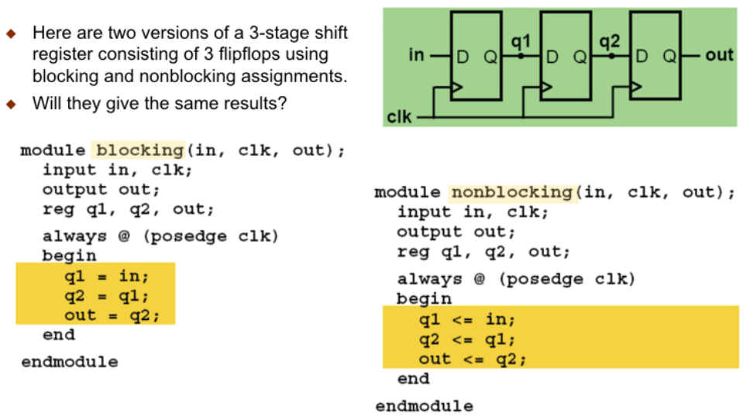
Blocking vs NonBlocking
Notes:
Understanding the difference between ‘=‘ and ‘<=‘ is important. Suppose we want to specify a three-stage shift register (i.e. three D-FF in series as shown in the schematic).
Here are two possible specification. Which one do you think will create the correct circuit and which one is wrong?

Slide 26
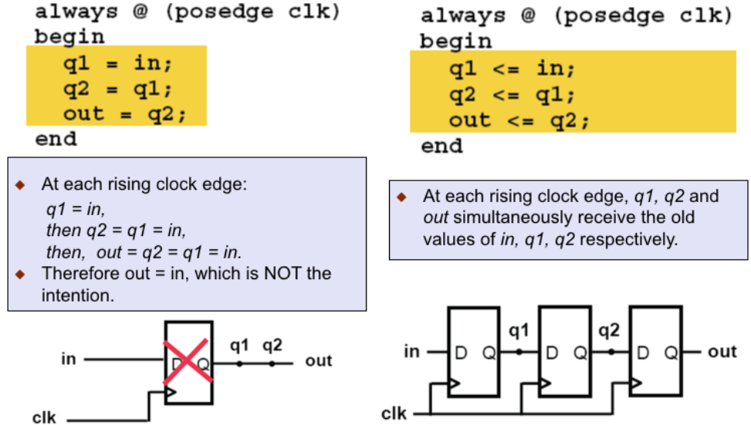
Notes:
The left hand specification is wrong. Since the three assignments are performed in sequence, out = q2 = q1 = in. Therefore the resultant circuit is ONE D-flipflop.
The right hand side is correct. q1, q2 and out are updated simultaneously on exit from the always block. Therefore their “original” values MUST be retained. Hence this will result in three D-flipflops being synthesised (i.e. created).
In general, you should always use ‘<=‘ inside an always block to specify your circuit.

Slide 27
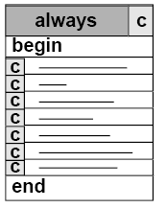
Blocking vs. Nonblocking Assignment
Blocking assignment always @(posedge clk) begin b = a; c = b; end
Nonblocking assignment always @(posedge clk) begin b <= a; c <= b; end
i.e. a = b = c
a
c
clk
D
Q
D
Q
a
1
2
3
4
b
1
2
3
4
1
2
3
4
c
1
2
3
4
1
2
3
4
clk
a
b
c
clk
D
Q
D
Q
D
Q
a
1
2
3
4
b
1
2
3
4
1
2
3
4
c
1
2
3
1
2
3
clk

Slide 28
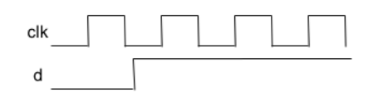
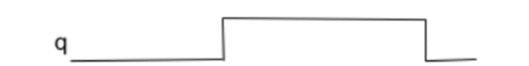
Six guidelines for using blocking and non-blocking assignment statments
1. Flip-flops should use non-blocking
2. Latches should use non-blocking
3. Combinational logic should use blocking
4. Do not mix combinational and sequential logic in the same always block
Hard to debug with waveform
5. Do not assign to the same variable from more than one always block
See Multi-driver slide in the “Gotcha” part
Sequential logic
always @( posedge clk )
begin
q <= d ? (a+1): (d+f);
end
Input change here
Output change here, not sync

Slide 29
Six guidelines for using blocking and non-blocking assignment statements
Do not mix blocking and non-blocking assignment
always @( posedge clk )
begin
q <= d ? (a+1): (d+f);
a = c + d;
end
6.375 Complex Digital Systems

Slide 30
Continuous and procedural assignment statements are very different
Continuous assignments are for naming and thus we cannot have multiple assignments for the same wire
wire out, t0, t1;
assign t0 = ~( (sel[1] & c) | (~sel[1] & a) );
assign t1 = ~( (sel[1] & d) | (~sel[1] & b) );
assign out = ~( (t0 | sel[0]) & (t1 | ~sel[0]) );
Procedural assignments hold a value semantically, but it is important to distinguish this from hardware state
reg out, t0, t1, temp;
always @( * )
begin
temp = ~( (sel[1] & c) | (~sel[1] & a) );
t0 = temp;
temp = ~( (sel[1] & d) | (~sel[1] & b) );
t1 = temp;
out = ~( (t0 | sel[0]) & (t1 | ~sel[0]) );
end
想像成有實際電路
同名，代表會被接再一起，
會無法決定真正的值該是多少
Illegal for this, multiple driver
assign temp = ~( (sel[1] & c) | (~sel[1] & a) );
assign t0 = temp;
assign temp = ~( (sel[1] & d) | (~sel[1] & b) );
assign t1 = temp;
assign out = ~( (t0 | sel[0]) & (t1 | ~sel[0]) );
在always中，只是文法上的姓名，不代表真的硬體
6.375 Complex Digital Systems

Slide 31
Continuous and procedural assignment statements are very different
Continuous assignments are for naming and thus we cannot have multiple assignments for the same wire
wire out, t0, t1;
assign t0 = ~( (sel[1] & c) | (~sel[1] & a) );
assign t1 = ~( (sel[1] & d) | (~sel[1] & b) );
assign out = ~( (t0 | sel[0]) & (t1 | ~sel[0]) );
Procedural assignments hold a value semantically, but it is important to distinguish this from hardware state
reg out, t0, t1, temp;
always @( * )
begin
temp = ~( (sel[1] & c) | (~sel[1] & a) );
t0 = temp;
temp = ~( (sel[1] & d) | (~sel[1] & b) );
t1 = temp;
out = ~( (t0 | sel[0]) & (t1 | ~sel[0]) );
end
Illegal for this, multiple driver
assign temp = ~( (sel[1] & c) | (~sel[1] & a) );
assign t0 = temp;
assign temp = ~( (sel[1] & d) | (~sel[1] & b) );
assign t1 = temp;
assign out = ~( (t0 | sel[0]) & (t1 | ~sel[0]) );
6.375 Complex Digital Systems

Slide 32
A completed Example
Notes:
6 pages

Slide 33
Example
把sequential logic 和 combinational logic 分開
Sequential logic => 各種的DFF，沒有logic equation
module design(
// input
input [7:0] data_in,
// system
input clk_p,
input rst_n,
// output
output logic [7:0] data_out
);
logic [7:0] value_w;
// combinational circuit
always_comb
beign
value_w = data_in + 7’d1;
end
// sequential circuit
always_ff@(posedge clk_p, negedge rst_n)
begin
if(~rst_n)begin
data_out <= 7’d0;
end else begin
data_out <= value_w;
end
end
endmodule
Module
Combinational logic
Sequential logic
IN
Reg.
OUT
Reg.
Reg.
Notes:
畫圖
C style
error: count = count + 1;
Schematic style
Separated comb/seq
Combined comb/seq

Slide 34
Example
Separate combinational logic and sequential logic
Sequential logic: only DFF
module design(
// input
input [7:0] data_in,
// system
input clk_p,
input rst_n,
// output
output logic [7:0] data_out
);
logic [7:0] value_w;
// combinational circuit
always_comb
beign
value_w = data_in + 7’d1;
end
// sequential circuit
always_ff@(posedge clk_p, negedge rst_n)
begin
if(~rst_n)begin
data_out <= 7’d0;
end else begin
data_out <= value_w;
end
end
endmodule
Module
Combinational logic
Sequential logic
IN
Reg.
OUT
Reg.
Reg.
Notes:
畫圖
C style
error: count = count + 1;
Schematic style
Separated comb/seq
Combined comb/seq

Slide 35
Simple testbench
`timescale 1ns/1ps //time resolution
`include “design.v”
`include “pattern.v”
module testbench;
// inter connection wire
wire clk_p;
wire rst_n;
wire [7:0] data_in;
wire [7:0] data_out;
// connection, test pattern
pattern U_pattern(
.clk_p(clk_p),
.rst_n(rst_n),
.data_in(data_in),
.data_out(data_out));
//my design
design U_design(
.clk_p(clk_p),
.rst_n(rst_n),
.data_in(data_in),
.data_out(data_out));
// dumpping waveform
initial begin
$fsdbDumpfile(“waveform.fsdb”);
$fsdbDumpvars;
end
endmodule
Save waveforms of all variables
testbench.v
Test pattern generation and response check
pattern.v
design.v
DUT
Notes:
如何學寫testbench/ test pattern => 依樣畫葫蘆就可以了

Slide 36
Simple testbench (SystemVerilog Version)
Defines the time units and simulation precision (smallest increment)
`timescale <reference_time_unit> / <time_precision>
reference_time_unit: simulation time unit
time_precision: unit for rounding
The precision unit must be less than or equal to the time unit
`timescale 1ns/1ps //time resolution
`include “design.v”
`include “pattern.v”
module testbench;
// inter connection wire
wire clk_p;
wire rst_n;
wire [7:0] data_in;
wire [7:0] data_out;
// connect test pattern
pattern U_pattern(
.*);
//my test
design U_design(
.*));
// dumpping waveform
initial begin
$fsdbDumpfile(“waveform.fsdb”);
$fsdbDumpvars;
end
endmodule
`ifdef RTL
`timescale 1ns/100ps
`endif
//finer resolution for gate level
`ifdef GATE
`timescale 1ns/10ps
`endif
//global parameters for all modules
`define CLK_PERIOD 30.0

Slide 37
Simple test pattern
module pattern(
clk_p,
rst_n,
data_in,
data_out
);
// parameter setting
parameter cycle = 10;
parameter Th = 2;
// I/O declaration
output clk_p;
output rst_n;
output [7:0] data_in;
input [7:0] data_out;
reg clk_p;
reg rst_n;
reg [7:0] data_in;
// clock
always begin
#(cycle/2.0) clk_p = 1’b1;
#(cycle/2.0) clk_p = 1’b0;
end
initial begin
// reset
rst_n = 1’b1;
wait(clk_p!==1’bx);
@(negedge clk_p);
rst_n = 1’b0;
@(negedge clk_p);
rst_n = 1’b1;
// stimulus generation
@(posedge clk_p);
#(Th)
data_in = 8’d8; // 1st cycle
@(posedge clk_p);
#(Th)
data_in = 8’d2; // 2nd cycle
……
$finish;
end
endmodule
Finish simulation

Slide 38
Note: Hierarchical Reference Names
Every identifier in a Verilog HDL description shall have a unique hierarchical path name.
The hierarchy of names can be viewed as a tree structure.
Hierarchical name referencing allows free data access to any object from any level in the hierarchy.
module Top wire SBUS
function FUNC
module CHILD
reg ART
task PROC
reg ART
block BLA
integer DOT
block BLB
reg ART, CIT
TOP.SBUS
TOP.CHILD.ART
TOP.PROC.ART
TOP.PROC.BLB.CIT / TOP.PROC.BLA.DOT

Slide 39
For loop in Verilog design (only within procedural blocks)
Notes:
https://ithelp.ithome.com.tw/articles/10191934
13 pages

Slide 40
for Loop
Provide a shorter way to express a series of statements.
Loop index variables must be integer type.
Step, start & end value must be constant.
In synthesis, for loops loops are “unrolled”, and then synthesized.
always@( a or b )begin
for( i=0; i<4; i=i+1 )c[i] = a[i] & b[i];
end
always@( a or b ) begin
c[0] = a[0] & b[0];
c[1] = a[1] & b[1];
c[2] = a[2] & b[2];
c[3] = a[3] & b[3];
end

Slide 41
FOR Loop in Hardware
Equivalent to repeat multiple hardware units
int matrix[9];
for(idx=0;idx<9;idx++){
matrix[idx] = 0;
}//C code
always@(posedge clk)begin
matrix[0] <= 0;
matrix[1] <= 0;
matrix[2] <= 0;
matrix[3] <= 0;
matrix[4] <= 0;
matrix[5] <= 0;
matrix[6] <= 0;
matrix[7] <= 0;
matrix[8] <= 0;
end
reg[31:0]matrix[8:0];
always@(posedge clk)begin
if(reset)
for(idx=0; idx <9; idx = idx +1)begin
matrix[idx] <= 0;
end
end //Verilog code
Reset a matrix to zero

Slide 42
Add 1 to 10 with for loop
A wrong example
Iteration in a Verilog “for” loop is not what you think as in C
Equivalent to expand the for loop
always@(posedge clk)begin
temp <= temp+0;
temp <= temp+1;
temp <= temp+2;
temp <= temp+3;
.
.
.
temp <= temp+9;
end
reg [7:0]temp;
always@(posedge clk)begin
for(idx=0;idx<10;idx=idx+1)begin
temp <= temp+idx;
end
end
Notes:
在verilog使用for loop時，他會把你的for做展開，並每次時脈正緣觸發時去做always block所要求的動作，所以如果要做像是迭代的運算的話在verilog就不能用for loop實現

Slide 43
Add 1 to 10 with for loop
Use counter instead
Counter for 0 to 9
Accumulator for summation
Note.
When you use for loop
Try to expand it to see if it matches what you think or not
reg[3:0]counter, temp;
assign counter_nxt = (counter == 10) ? counter : counter + 1;
always@(posedge clk)begin
if(reset)
counter <= 0;
else
counter <= counter_nxt;
end
assign temp_nxt = temp + counter;
always@(posedge clk)begin
if(reset)
temp <= 0;
else if(counter<10)
temp <= temp_nxt;
end
Notes:
累加一個值十次: 正確例子 (從1加到10)
要用for loop 請先展開看看合不合

Slide 44
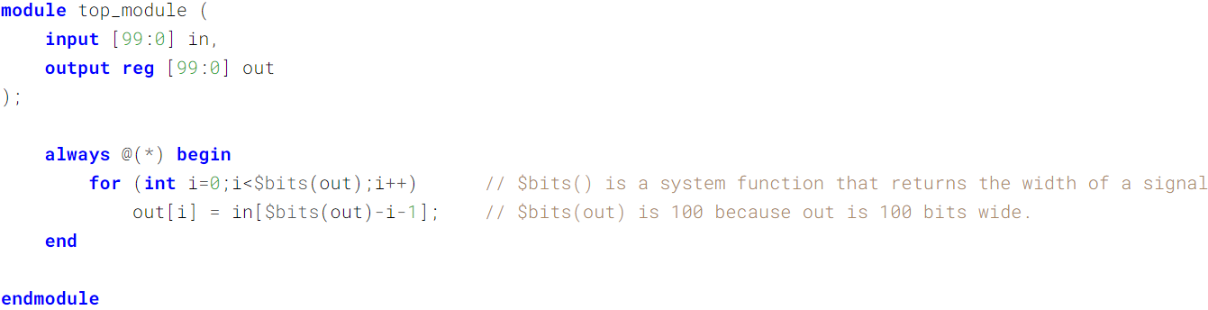
Bit Reversal
Given a 100-bit input vector [99:0], reverse its bit ordering
Notes:
https://hdlbits.01xz.net/wiki/Vector100r

Slide 45
Improper Loop Use (1/2)
input [‘N-1:0] a;
output [‘N-1:0] b;
integer i;
reg [‘N-1:0] b;
always @ (a) begin
for (i=0; i<=‘N-1; i=i+1)
b[i] = ~a[i];
end
input [‘N-1:0] a;
output [‘N-1:0] b;
assign b = ~a;
BAD
bit visit
loop overhead
Good
bus visit
parallel evaluation

Slide 46
Improper Loop Use (2/2)
Bus Reversal
input [15:0] a;
output [15:0] b;
integer i;
reg [15:0] b;
always @ (a) begin
for (i=0; i<=15; i=i+1)
b[15 - i] = a[i];
end
input [15:0] a;
output [15:0] b;
assign b = { a[0], a[1], a[2], a[3], a[4], a[5], a[6], a[7], a[8], a[9], a[10], a[11], a[12], a[13], a[14], a[15] };
BAD
loop overhead
Good
concatenation

Slide 47
for Loop
It simulates slow
from 10X to > 1000X slower than non-for loop versions
It synthesizes slow
Memory clear
legitimate for loop use in chip design
Avoid using the for loop whenever possible

Slide 48
Parameterized design

Slide 49
Generate Example (1/2): 8-bit adder
generate
genvar i;
for(i = 0; i <= 7; i = i + 1)
begin: u
adder8 add(sum[(i*8)+:8], co[i+1],
a[(i*8)+:8], b[(i*8)+:8], ci[i]);
end
endgenerate
u[0].add, u[1].add, …, u[7].add are generated
Verilog-2001

Slide 50
Generate Example (2/2): conditional generation
module multiplier (a, b, product);
parameter a_width = 8, b_width = 8;
localparam product_width = a_width + b_width;
input [a_width-1:0] a;
input [b_width-1:0] b;
output [product_width-1:0] product;
generate
if ((a_width < 8) || (b_width < 8))
CLA_multiplier #(a_width, b_width) u1 (a, b, product);
else
WALLACE_multiplier #(a_width, b_width) u1 (a, b, product);
endgenerate
endmodule
Verilog-2001
localparam is for local parameters, it cannot be used within module port parameter list
Notes:
localparam is for local parameters, it cannot be used within module port parameter list

Slide 51
Generate
Use for loops to generate any number of instances of:
modules, primitives, procedures, continuous assignments, tasks, functions, variables, nets
Use if–else and case decisions to control what instances are generated
provides greater control than the VHDL generate
New reserved words added:
generate, endgenerate, genvar

Slide 52
Simulator and race conditions How simulator works for hardware execution and thus how race conditions occur
Notes:
21 pages

Slide 53
Verilog Simulator

Slide 54
Simulation of a Verilog Model
Verilog simulation takes the following steps:
1. Compilation:
The design description is read, compiler directives are processed, and a data structure is built that defines the design hierarchy.
2. Initialization:
During initialization, parameters are initialized, undriven nets default to Z, and other nodes get the value X. These values propagate through the design hierarchy as they do during a real simulation.
3. Simulation:
When simulation commences at simulation time zero, the simulator executes the statements in each initial and always block that are not preceded by timing controls. These assignments can trigger events at time zero and at later times.
When time advances, scheduled events are executed, causing more events to be scheduled. This process continues throughout simulation.

Slide 55
The Time Wheel in Event-Based Simulation (1/2)
Event-based simulation
They simulate only those elements that might cause a change in circuit state.
The simulator creates the initial queues upon compiling the data structures
Time advances only after every event scheduled for that time is processed
The time wheel can only go forward
Simulation events that occur in the same timeslice would be concurrent in hardware.
More one event at each time stamp
Notes:
在時間軸上的每一點，可以有一個以上的event被安排

Slide 56
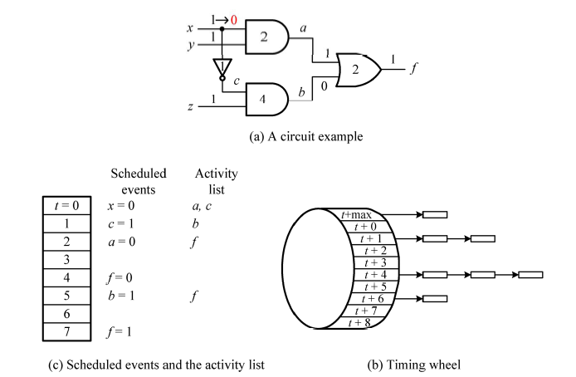
The Time Wheel in Event-Based Simulation (2/2)
Digital System Designs and Practices Using Verilog HDL and FPGAs, John Wiley

Slide 57
Compiler Directive: `timescale (1/2)
`timesale 1ns/10ps
The `timescale compiler directive declares the time unit and its precision.
`timescale <time_unit> / <time_precision>
<time_unit> specifies the units of measurement for delays and time.
<time_precision> tells the simulator how to round delay values before using them in simulation.
The time_precision must be at least as precise as the time_unit.
The time_precision and time_unit both consist of an integer and a character string representing the magnitude and the unit, respectively.
The valid integers are 1, 10, and 100.
The valid unit strings are s(second), ms(millisecond), ns(nanosecond), us(microsecond), ps(picosecond), and fs(femtosecond).
Any combination of these is allowed.
A `timescale compiler directive applies to all module definitions that follow it in the source description until the compiler reads another `timescale compiler directive. It is recommended that the only one `timescale compiler directive declared in top module of your design.

Slide 58
Compiler Directive: `timescale (2/2)
The `timescale compiler directive must appear before a module boundary.
Unit / Precision | Delay Specification | Time Delayed
10ns / 1ns | #7 | 70 ns
10ns / 1ns | #7.748 | 77 ns
10ns / 1ns | #6.17 | 62 ns
10ns / 100ps | #7.748 | 77.5 ns
1ns / 100ps | #5.22 | 5.2 ns
`timesale 1ns/10ps
module mux2_1 ....
...
not #1 (sel_, sel);
and #2 (a1, a, sel_);
and #2 (b1, b, sel);
or #1 (out, a1, b1);
...
...
endmodule
n: 10⁻⁹
p: 10⁻¹²
Note :
Error messages will occur if no `timescale setting before the first module
Set `timescale only at the top module

Slide 59
When to Update the Output Values (LHS)
Assignment statement
operands
A = (B + C) << D ;
Expression
RHS: right hand side
operators
LHS: left hand side
wire / reg
Procedural assignment
Continuous assignment

Slide 60
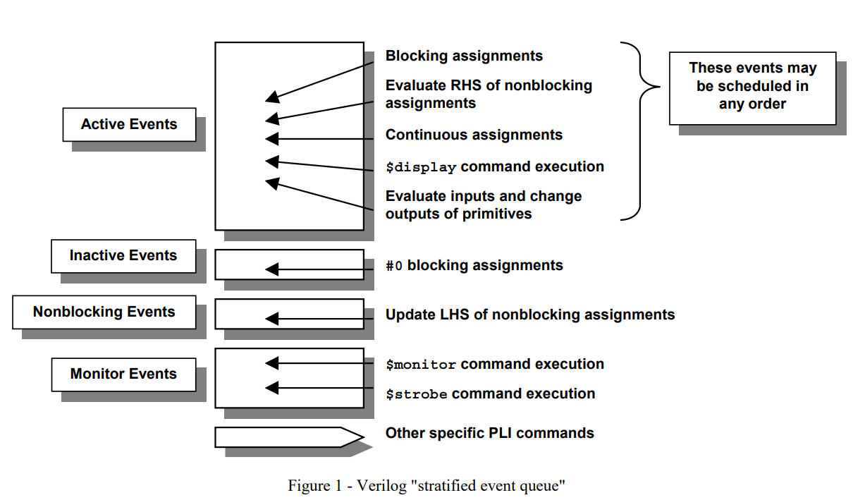
Event Queue for Each Time Stamp

Slide 61
Race Conditions
When two expressions are scheduled to execute at same time, and if the order of the execution is not determined, then race condition occurs.
https://blogs.sw.siemens.com/verificationhorizons/2020/07/27/systemverilog-race-condition-challenge/
https://blogs.sw.siemens.com/verificationhorizons/2020/08/13/systemverilog-race-condition-challenge-responses/

Slide 62
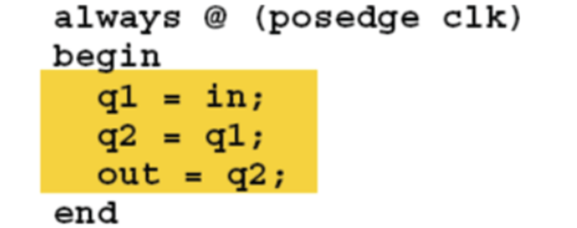
Race Conditions
Execution of blocking assignments can be viewed as a one-step process:
Evaluate the RHS (right-hand side equation) and update the LHS (left-hand side expression) of the blocking assignment without interruption from any other Verilog statement.
A problem with blocking assignments occurs when the RHS variable of one assignment in one procedural block is also the LHS variable of another assignment in another procedural block and both equations are scheduled to execute in the same simulation time step, such as on the same clock edge.

Slide 63
Race Conditions
always @(posedge clk or posedge rst)
if (rst) y1 <= 0; // reset
else y1 <= y2;
always @(posedge clk or posedge rst)
if (rst) y2 <= 1; // preset
else y2 <= y1;
module fbosc1 (y1, y2, clk, rst);
output y1, y2;
input clk, rst;
reg y1, y2;
always @(posedge clk or posedge rst)
if (rst) y1 = 0; // reset
else y1 = y2;
always @(posedge clk or posedge rst)
if (rst) y2 = 1; // preset
else y2 = y1;
endmodule
Example 1 - Feedback oscillator with blocking assignments
Better with nonblocking assignments
Execute first, resetted y2 =1; y1=y2; y1=> 1, y2 = y1; y2=1;
Execute first, resetted y1 =0; y2=y1; y2=> 0, y1 = y2; y1 = 0;
the two "always" blocks can be scheduled in any order. If the first always block executes first after a reset, both y1 and y2 will take on the value of 1. If the second "always“ block executes first after a reset, both y1 and y2 will take on the value 0. This clearly represents a Verilog race condition.
Notes:
According to the IEEE Verilog Standard, the two "always" blocks can be
scheduled in any order. If the first always block executes first after a
reset, both y1 and y2 will take on the value of 1. If the second "always"
block executes first after a reset, both y1 and y2 will take on the value 0.
This clearly represents a Verilog race condition.

Slide 64
Mixed Sequential & Combinational Logic - Use Nonblocking Assignments
module nbex2 (q, a, b, clk, rst_n);
output q;
input clk, rst_n;
input a, b;
reg q;
always @(posedge clk or negedge rst_n)
if (!rst_n) q <= 1'b0;
else q <= a ^ b;
endmodule
This is convenient, but hard to debug
Separate combinational and sequential logic to two always blocks
always @(a or b)
y = a ^ b;
always @(posedge clk or negedge rst_n)
if (!rst_n) q <= 1'b0;
else q <= y;
Notes:
12.0 Mixed Sequential & Combinational Logic - Use Nonblocking Assignments ------------------------------------------------------------------------- It is sometimes convenient to group simple combinational equations with sequential logic equations. When combining combinational and sequential code into a single always block, code the always block as a sequential "always" block with nonblocking assignments as shown in Example 22. module nbex2 (q, a, b, clk, rst_n); output q; input clk, rst_n; input a, b; reg q; always @(posedge clk or negedge rst_n) if (!rst_n) q <= 1'b0; else q <= a ^ b; endmodule Example 22 - Combinational and sequential logic in a single "always" block The same logic that is implemented in Example 22 could also be implemented as two separate "always" blocks, one with purely combinational logic coded with blocking assignments and one with purely sequential logic coded with nonblocking assignments as shown in Example 23. module nbex1 (q, a, b, clk, rst_n); output q; input clk, rst_n; input a, b; reg q, y; always @(a or b) y = a ^ b; always @(posedge clk or negedge rst_n) if (!rst_n) q <= 1'b0; else q <= y; endmodule Example 23 - Combinational and sequential logic separated into two "always" blocks Guideline #4: When modeling both sequential and combinational logic within the same "always" block, use nonblocking assignments.

Slide 65

Mixed Blocking & Nonblocking Assignment
always @(posedge clk or negedge rst_n) begin: ff
reg tmp;
if (!rst_n) q <= 1'b0;
else begin
tmp = a & b;
q <= tmp;
end
end
- Blocking and nonblocking assignment in the same "always" block; generally a bad idea!
both simulate and synthesize correctly because the blocking assignment is not made to the same variable as the nonblocking assignments.
always @(posedge clk or negedge rst_n)
if (!rst_n) q = 1'b0; // blocking assignment to "q"
else begin
tmp = a & b;
q <= tmp; // nonblocking assignment to "q"
end
Simulate correct but is not synthesizable
Notes:
The code in Example 24 will both simulate and synthesize correctly because
the blocking assignment is not made to the same variable as the nonblocking
assignments. Although this will work, I discourage this coding style.
The code in Example 25 will most likely simulate correctly most of the time,
but Synopsys tools will report a syntax error because the blocking
assignment is assigned to the same variable as one of the nonblocking
assignments. This code must be modified to be synthesizable.

Slide 66
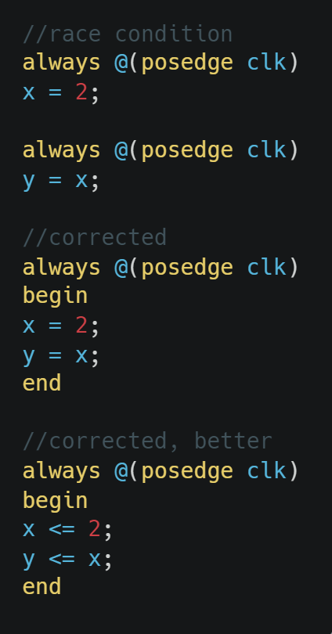
Non-Deterministic Simulation Order
Read-Write or Write-Read race condition
//---------------------------------------
// Race #1
//
// Blocking and non-blocking assignments
//---------------------------------------
byte slam;
bit dunk;
initial begin
forever begin
@(posedge clk);
dunk = ~dunk;
slam += dunk;
end
end
always @(posedge clk) basket <= slam + dunk;
Notes:
https://www.vlsiencyclopedia.com/2012/08/race-condition-in-verilog.html

Slide 67
Non-Deterministic Simulation Order
Read-Write or Write-Read race condition
//read-write race condition
always @(posedge clk)
x = 2;
always @(posedge clk)
y = x; //new or old x value?
//corrected
always @(posedge clk)
begin
x = 2;
y = x;
end
//corrected, better
always @(posedge clk)
begin
x <= 2;
y <= x;
end
Use nonblocking assignment for sequential block
always@(posedge clk), always_ff@
Use blocking assignment for combinational block
always@*, always_comb
Notes:
https://www.vlsiencyclopedia.com/2012/08/race-condition-in-verilog.html

Slide 68
Race Condition: Multiple Drivers
Write-Write race condition
//Write-Write Race, multiple drivers,
//correct this with nonblocking assignment
always @(posedge clk)
a = 1;
always @(posedge clk)
a = 5;
//Write-Write Race, multiple drivers
//not correctable
always @(posedge clk)
a = 1
assign a = 5;
http://www.testbench.in/TB_16_RACE_CONDITION.html
Notes:
https://www.vlsiencyclopedia.com/2012/08/race-condition-in-verilog.html

Slide 69
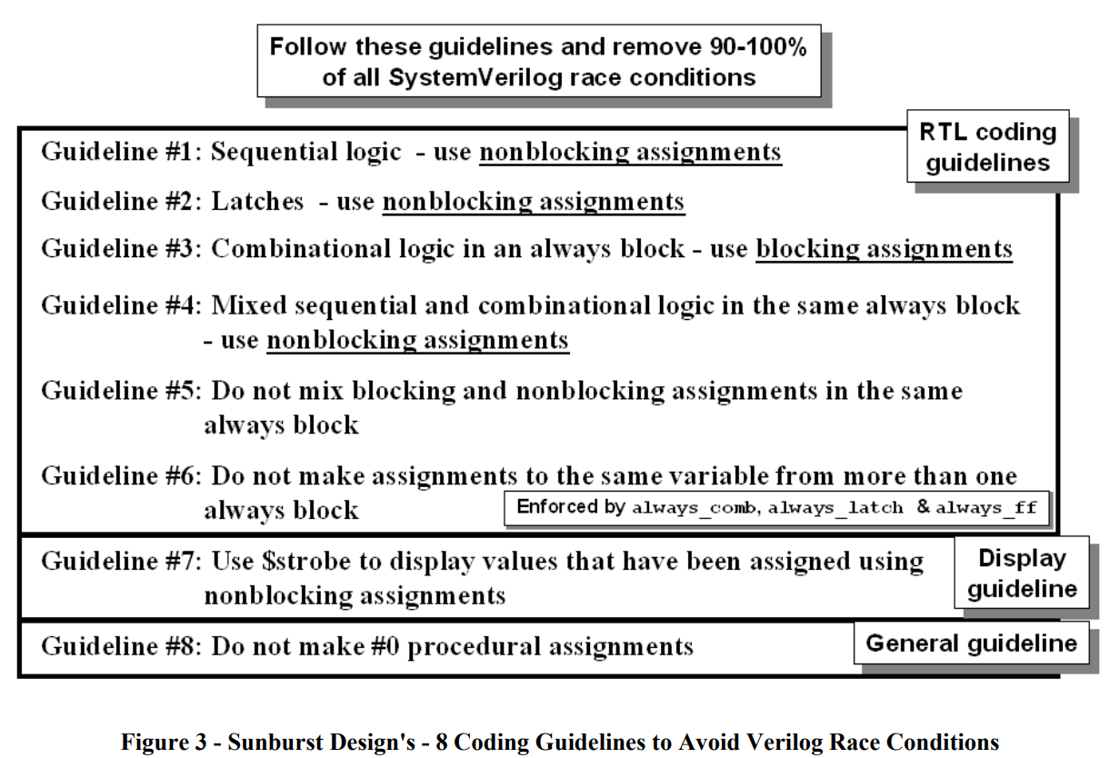
SystemVerilog Event Regions, Race Avoidance & Guidelines
Notes:
Best strategy: do not spend time to guess what will be correct for these race conditions
Use the following guidelines so that you will have no race conditions. And everything is under your control

Slide 70
Execution Timing Diagram
assign, always @(posedge clk), assign @(a), initial
initial begin
clk = 0;
end
always begin
#10 clk = ~clk;
end
always @(posedge clk)
k <= a + b;
assign b = m&n;
assign c = d|k;
assign: executed at all time stamp
simulation time 0 5 10 15 20 25 30 35 40
clk
Trigger points

Slide 71
Execution Timing
Continuous assignment: assign, executed at all time
Procedural blocks are of two types:
initial procedural blocks, which execute only once. (initialization and waveform generation)
always procedural blocks, which execute in a loop.
Depends on @ trigger points
Event triggered:
@(posedge clk) positive edge triggered,
@*, @(a or b) signal changed triggered
The assign, initial and always constructs are enabled at the beginning of a simulation.
Any number of assign, initial and always statements may appear within a module
assign, initial and always statements all execute in parallel. (no implied order)

Slide 72
Put Things in the Right Place
module adder (…);
always @(…)
begin
and (a, b, c );
assign sum = a + b;
end
endmodule
module adder (…);
sum = a + b ;
always @(…)
begin
….
end
endmodule
module adder (…);
If (sl==1);
sum = a+b;
always @(…)
begin
….
end
endmodule
Do not put assign within always block
Legal but is not synthesizable
Single line statement outside procedure blocks should use assign
Correct
assign sum = a+b;
Control statements like if-else, case, for
should be within procedure blocks like always, initial

